Slide 1
LGBTQ Youth Issues
Presented by Susan M Frawley
Board member of Niagara Pride

Slide 2
Invitation to learn
Increase knowledge about LGBTQ+
Examine self attitude about the LGBTQ+ community
Encourage personal changes to reduce harm and create safe access for LGBTQ+
Agreements for being here today:
Be fair
Be safe
What is said in confidence, stays in confidence
What is learned here today, goes out into the world!

Slide 3
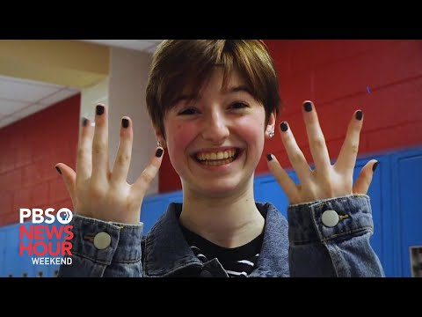

Slide 4
LGBTQIAA Whats it all mean????
Lesbian, Gay, Bisexual, Transgender, Queer +
Questioning, Asexual, Ally, Intersex , Two Spirit,
Gender Non Conforming, Gender Fluid, Non Binary, Pan sexual, Androgynous and more … There are 70 terms for Queer Gender/ Sexual identities.
Personal Pronouns….. She/Her , He /Him , They /Them , He/They, Hir/Hirst, ey/em, zie/zim, vers/verself and more

Slide 6
Notes:
[CANDICE]
Meet the “Gender Unicorn,” which is a fun visual to think about gender beyond body parts
The “Gender Unicorn” is a way to think about how gender identity, gender presentation/expression, sex assignment at birth, and attraction are difference and distinct
Let’s break it down:
Gender Identity: One’s internal sense of being male, female, neither of these, both, or another gender(s). Everyone has a gender identity, including you. For transgender people, their sex assigned at birth and their own internal sense of gender identity are not the same. “Female,” “woman,” and “girl” and “male,” “man,” and “boy” are also not necessarily linked to each other, but are just six common gender descriptions.
Gender Expression/Presentation: The physical manifestation of one’s gender identity through clothing, hairstyle, voice, body shape, etc. Many transgender people seek to make their gender expression (how they look) match their gender identity (who they are), rather than their sex assigned at birth.
Sex Assigned at Birth: The assignment and classification of people as male, female, intersex, or another sex based on a combination of anatomy, hormones, chromosomes.
Who We Are Physically Attracted To: Sexual orientation. It is important to note that sexual and romantic/emotional attraction can be from a variety of factors including but not limited to gender identity, gender expression/presentation, and sex assigned at birth.
Who We Are Emotionally Attracted To: Romantic/emotional orientation. It is important to note here that sexual and romantic/emotional attraction can be from a variety of factors including but not limited to gender identity, gender expression/presentation, and sex assigned at birth. There are other types of attraction related to gender such as aesthetical or platonic. These are simply two common forms of attraction.
While the lines on this “Gender Unicorn” chart are linear, gender is not; but what it does do well is show have gender as moveable and fluid across each category
The only “fixed” position is the sex we are “assigned” at birth based on how we are categorized by gender marker - but this is changing!
If you take anything away from this graphic, which honestly lumps together some pretty complex concepts, is that everyone one of us (parents included!) are represented on this gender unicorn!
Each of us was issued a sex assignment at birth and carry our gender identity (that may or may not align with our sex assigned at birth), and ways of expressing our gender. We also possess our own map of physical and emotional attraction that has most likely developed over time. This is the same as our kids!

Slide 7
The Transgender, “Gender Journey” & Transition
Gender dysphoria (or not)
How do non-binary folx fit in?
Social transitioning (outward appearance)
Hormone blockers and hormones
Surgery (top and bottom)
*the trans experience is unique and different for each person who identifies as trans - all feelings and choices during this journey are valid*
Notes:
[SUE]

Slide 8
What Defines Someone as “Transgender”?
“A transgender person is someone whose gender identity differs from the sex/gender assigned at birth.” (GLAAD and National Center for Transgender Equity)
There are approximately 1.4 million transgender adults in the US and more youth that are not fully represented by data.
Someone who identifies as transgender:
may change their given birth name,
may dress in a manner consistent with the gender they identify with,
may identify as straight or queer in their affectional choices,
may medically transition to bring their body into alignment with their gender identity through hormone therapy and gender affirming surgery…
or none or some of those items mentioned - the experience is unique to each individual and all choices are valid
Transgender youth are coming out at younger ages, some as young as 3 or 4 years old.

Slide 9
Pronouns!
Pronouns are personal
Respecting pronouns saves lives
Don’t require sharing pronouns, it could out someone
Start with yourself! Practice, Practice, Practice, Practice !!!
Try saying: “Hi, my name is _______ and my pronouns are ______. Would you like to share your name and pronouns?”
Young people tend to change their pronouns as they explore and discover who they are.
It’s normal and part of child development.
Try to make statements or narratives that are gender neutral so as to be inclusive.
Notes:
[SUE]

Slide 11
What do I say to a LGBTQ+ person?
“Hi.” You could share your pronouns. Be careful of insisting on another sharing theirs. Pronouns are personal. You could “out” someone by demanding pronouns.
Use inclusive language always. You never know who you are talking to..it might be a mother, son, spouse, brother, or aunt of an LGBTQ+ person. Don’t assume parents are Mom and Dad. It could be Dad and Dad, Mom and Mom or just one parent/caregiver or a host of other makeups of family
Do ask a clarifying question if you don’t understand a term or phrase that someone has used.
Not all LGBTQ+ people use pronouns, are out, feel comfortable talking about their gender identity or sexual orientation. Most times, it is not information that needs to be shared. When it comes to education, medical, court or placement; that information can be critical to providing good service. Be gentle, direct, discreet, give time for the person to assess you as a safe space.

Slide 12
40-80%
Local Statistic:
At any given time the census for inpatient mental health is 40-80% LGBTQ+ identifying. More often than not, that statistic is in the higher range of 80%. (CPC WNY)

Slide 13
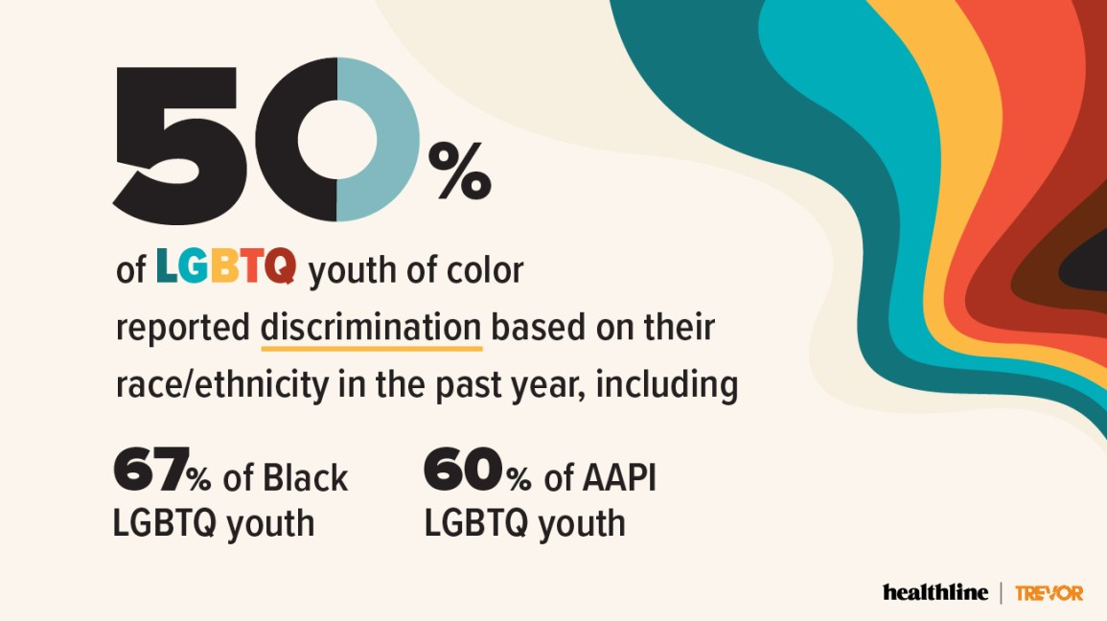
Health Issues for LGBTQ+ Youth
Disproportionately higher risks for:
Social stigmatization
Discrimination
Harassment
Family disapproval or rejection
Experiencing violence
STIs (especially syphilis and HIV)
Pregnancy
Abortions
Suicide
Sexual victimization
Reluctance to seek medical care due to:
lack of insurance
fear of exposing identity
being “outed” to family
The Trevor Project National Survey on LGBTQ+ Youth Mental Health 2020
Notes:
[CANDICE]

Slide 14
LGBTQ Youth Experience Higher Rates of Substance Abuse
LGBTQ youth are 190% more likely to use substances than their heterosexual, cisgender peers
LGBTQ youth are more likely to use illegal substances at younger ages than heterosexual use
A California study found that Transgender and Gender Non-Conforming youth are:
2.5x more likely to use cocaine/methamphetamines
2x more likely to misuse pain medication
3x more likely to use cigarettes
LGBTQ youth are more likely to succeed in treatment where they feel safe to address all the factors that contribute to use and/or relapse. Early intervention, comprehensive treatment and family support are the key to helping LGBTQ youth on the road to recovery.
For more information on LGBTQ-affirming providers,
please visit gaycenter.org/thenetwork or contact or contact network@gaycenter.org.
(Source: The NYS LGBT Health and Human Services Network)
Notes:
[SUE]

Slide 15
WHEN A YOUTH COMES OUT TO YOU:
Offer support but don’t assume they need any help
Be a role model of acceptance
Appreciate their courage
Listen, listen, listen
Assure and respect confidentiality
Ask questions and demonstrate understanding, acceptance and compassion
Have you been able to tell anyone else?
Has this been a secret you have had to keep from others or have you told other people?
Do you feel safe? Supported by the adults in your life?
Do you need any help of any kind? Resources or someone to listen?
Have I ever unknowingly offended you?
Remember that the youth has not changed
Challenge traditional norms
Be prepared to give a referral
Notes:
[SUE]
When a student comes out to you as LGBTQ your initial response is important. The student has likely spent time in advance thinking about whether or not to tell you, and when and how to tell you. Here are some tips to help you support them:
Your student may be completely comfortable in their identity and may not need help “dealing” with it or need any kind of support. It may just be that the student wanted to share this information with you so you might know them better. Just offer your support to them going forward if they should ever need it
Always model good behavior by using inclusive language and setting an accepting environment by not making assumptions about people’s identities. Addressing others’ (adults and students) biased language and addressing stereotypes and myths about LGBTQ people also positions you as a positive role model.
Consider someone’s coming out to you as a gift and thank them for giving that gift to you. Sharing this personal information with you means that the student respects and trusts you.
It is as simple as that.
Let the student know that the conversation is confidential and that you won’t share the information with anyone else, unless they ask for your help
They are still the same person you knew before the disclosure; you just have more information about them, which might improve your relationship. If you are shocked, try not to let the surprise lead you to view or treat the student any differently
As well as your own beliefs
Contact GLYS if you ever need a referral or use GLSEN’s Coming Out Resources which you can find on their website

Slide 16
4 WAYS TO BE A SUPPORTIVE ALLY:
BE VISIBLE
SUPPORT YOUTH WHO COME OUT TO YOU
RESPOND TO ANTI-LGBTQ+ LANGUAGE AND BEHAVIORS
SUPPORT GSAs
Notes:
One of the key ways to act in allyship is to support LGBTQ+ students in your school -- which you can do by following these 4 steps to being a supportive ally: being visible, supporting students who come out to you, responding to anti-LGBTQ language and behaviors and supporting student clubs such as GSAs.

Slide 17
WHAT IS A SAFE SPACE?
Safe Space: a supportive and affirming environment for LGBTQ+ students.
While we can never ensure that any space is going to be “safe” 100% of the time, a safe space is a place, group or community that is intentionally working to affirm LGBTQ+ students.
Notes:
We know that a majority of LGBTQ+ students feel unsafe at school and are likely to skip class or even full days of school to avoid anti-LGBTQ+ name calling, bullying and harassment. Educations hold the power to combat this -- they hold the dual position of controlling classroom environments and have a voice to advocate on LGBTQ+ student’s behalf to school administration -- this gives them an invaluable role in ensuring their school environment is safe for queer youth.
For many queer students, having adult allies in school whom they can turn to for support -- or even the simple knowledge that these allies exist -- can help create a welcoming and safe environment for students to learn. You do not need to be an “expert” on LGBTQ identities to be a visible ally in your school.

Slide 18
NYS Human Rights Laws cover LGBTQ+
GENDA Gender Expression Non-Discrimination Act: Discrimination on the basis of gender identity or expression is prohibited in all areas covered by the Human Rights Law, including employment, housing, places of public accommodation, and non-religious schools.
SONDA Sexual Orientation Non-Discrimination Act:
Discrimination on the basis of actual or perceived sexual orientation in employment, housing, public accommodations, education, credit, and the exercise of civil rights.
Gender Recognition Act:
Coming into full effect in 2022 - changing names, gender markers and bring recognized
DASA Dignity for All Students Act:
Protects students from discrimination on the basis of actual or perceived sexual orientation, gender identity and expression.

Slide 19
Questions ??????

Slide 20
Thank you for being here. If you would like more information
Contact Susan Frawley at susanfrawley@aol.com
Or Niagara Pride at www.niagarapride.org
Niagara Pride offers trainings and workshops on DEI, SOGI, and LGBTQ issues

