Slide 1
Medicaid in Erie County
An Analysis of Statistical Data for the Period January 1, 2016 through October 31, 2016 and selected prior periods

Slide 2
Medicaid
Joint Federal – State health insurance program that assists persons with low income and limited resources.
County governments administer Medicaid and pay a portion of Medicaid costs
Presently, due to these various funding adjustments and also due to the State’s “Medicaid Cap” process, the Erie County share of total Medicaid expense ranges from 11% to 15%.
The County’s annual expense for Medicaid-MMIS is still the single-largest appropriation account in Erie County’s operating budget.

Slide 3
Medicaid Mandatory Services
Mandatory Services: States Must Cover
Inpatient and outpatient hospital services Physician, midwife and certified nurse practitioner services Laboratory and x-ray services Nursing home and home health care for individuals over the age of 21 Early and periodic screening, diagnosis, and treatment (EPSDT) for children under 21 Family planning services and supplies Rural health care/federally qualified health center services

Slide 4
Medicaid Optional Services
Optional Services: States May Cover
Diagnostic, screening, preventive, rehabilitative services Clinical services Intermediate care facilities for the mentally retarded (ICFs/MR) Prescribed drugs and prosthetic devices Optometrist services and eyeglasses Nursing facility services for children under age 21 Transportation services (may be covered, must be assured) Physical and occupational therapy Home and community-based care to certain persons with chronic impairments Dental services (for adults) New York State covers nearly all the optional services for Medicaid.

Slide 5
New York State Medicaid Data Warehouse
Contains the individual transaction records for all Medicaid transactions in New York State
Database is covered by the legal and regulatory provisions of the Health Insurance Portability and Accountability Act (“HIPAA”). However, amalgamations of data are allowed.
MIG Team has access to the data for all of Erie County. Other County personnel have access to selected portions. This access allows the MIG Team to better focus audit work.

Slide 6
Erie County’s Medicaid Inspector General
Audits
Has completed or is in the process of completing 30 audits reviewing more than $89.7 million in Medicaid transactions
Works on a variety of projects and cooperate with NYS OMIG and law enforcement agencies.
Three employees and is funded through the State under a 2012 agreement.

Slide 7
Federal Medical Assistance Percentage
The Federal Medical Assistance Percentage (FMAP) is the federal share of Medicaid costs.
FMAP is calculated annually using a formula set forth in federal statute.
The FMAP for New York State for the federal government’s current fiscal year is 50%. New York State shares the lowest FMAP percentage in the nation with fifteen (15) other states. The highest FMAP percentage in 2016 is 74.17%.

Slide 8
Revised FMAP under the ACA
The Patient Protection and Affordable Care Act (ACA) creates a new national Medicaid minimum eligibility level: the “Medicaid Expansion.”
Income eligibility: In 2016, a family of four generally qualifies with an income of $32,319 or less per year.
In New York State, two adults working 40 hours per week for 50 weeks a year at the Minimum Wage make $36,000 annually.

Slide 9
Applying for Medicaid in Erie County
Pregnant women, children, disabled persons and others may be eligible for Medicaid if they have a higher income, under certain circumstances.
Medicaid can and does cover some costs retroactively, if a person would have been eligible had they applied earlier.
Coverage generally stops at the end of the month in which a person no longer meets eligibility requirements.

Slide 10
Selected 2016 Annual Poverty Guidelines & Medicaid Expansion
Family Size | 100% | 133% | 150% | 200%
1 | 11,880 | 15,800 | 17,820 | 23,760
2 | 16,020 | 21,307 | 24,030 | 32,040
3 | 20,160 | 26,813 | 30,240 | 40,320
4 | 24,300 | 32,319 | 36,450 | 48,600
5 | 28,440 | 37,825 | 42,660 | 56,880
In New York State, the Minimum Wage is $9.00 per hour as of December 31, 2015, leading to an annual minimum wage of about $18,000. (50 weeks X 40 hours per week)
Under the ACA Medicaid expansion, a family of 2 adults and 2 children, with both adults working at minimum wage, absent any special circumstances or additional income, would NOT qualify for Medicaid. ($36,000.00 in income.)
The above family would be able to purchase insurance through the NYS Health Plan Marketplace.

Slide 11
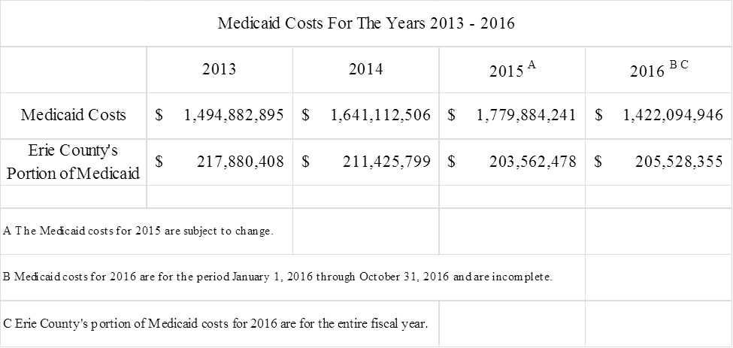
Medicaid Costs for 2014 - 2016

Slide 12
Medicaid Clients by Year
2013 | 2014 | 2015 | 2016*
238,814 | 268,332 | 286,145 | 278,473
The number of persons on Medicaid in Erie County has been and continues to grow at an average rate of more than four percent (4%) per year.
With the increase in Medicaid clients due to the ACA, 2015 Medicaid clients have exceeded 31% of Erie County’s population .
* 2016 Data covers the period of January 1, 2015 through October 31, 2016.

Slide 13
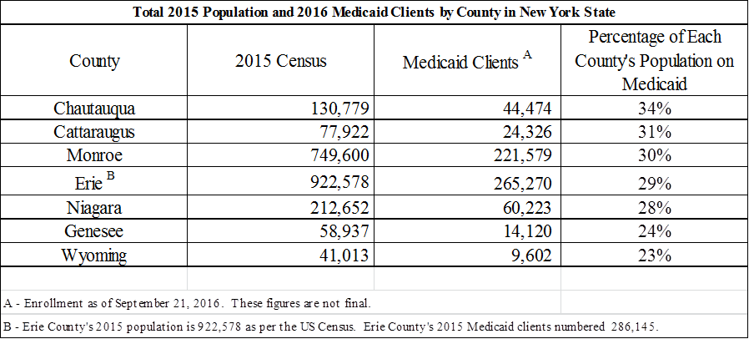
Medicaid Client Percentage by County

Slide 14
2015 Medicaid Cost and Client Summary
Race/Ethnicity | Medicaid Clients | Medicaid Cost
White | 137,322 | $ 1,021,427,050
Black/African American | 82,077 | 459,689,157
Hispanic/Latino | 26,304 | 133,741,293
Asian/Pacific Islander | 14,791 | 58,302,154
American Indian/Alaskan Native | 2,066 | 10,420,765
Not Available/More Than One Race | 23,585 | 96,303,822
Totals | 286,145 | $ 1,779,884,241
Note: All Medicaid clients self-identify for race and ethnicity.
There are more Whites on Medicaid in 2015 than Black/African American, Hispanic/Latino and Asian/Pacific Islander persons combined.

Slide 15
2015 Medicaid Summary by Age
Age Group | Medicaid Clients | Medicaid Cost
65 Years of Age and Older | 22,376 | $ 301,950,053
Age 21 – 64 | 148,946 | 1,123,767,647
Age 0 to 20 | 114,823 | 354,166,542
Totals | 286,145 | $ 1,779,884,241
More than 40% of the individuals on Medicaid are under the age of 21.

Slide 16
Medicaid Drugs in Erie County with the Most Filed Prescriptions – 2016*
Ibuprofen: Over the counter pain reliever
Omeprazole: Treats acid reflux
Hydrocodone-Acetaminophen: Treats moderate to severe pain
Atorvastatin Calcium: Treats elevated cholesterol
Lisinopril: Treats high blood pressure
Metaformin HCL: Treatment for type two diabetes
Ventolin HFA: Treats asthma or allergies
Amlodipine Besylate: Treats high blood pressure
Levothyroxine Sodium: Treats thyroid deficiency
Gabapentin: Anti-epileptic medication / pain treatment
Amoxicillin: Antibiotic
Aspirin: Over the counter pain reliever
* 2016 Data covers the period of January 1, 2016 through October 31, 2016.

Slide 17
For the first time since 2008
Hydrocodone-Acetaminophen is NOT the number one prescribed Medicaid drug in Erie County.
Considering that Hydrocodone-Acetaminophen is one of the most abused drugs in the U.S., this drop is significant.

Slide 18
Medicaid and Immigration
Medicaid does not cover individuals in the United States illegally.
Medicaid can cover non-United States citizens who are here legally.
Citizenship status is tracked and verified when an individual applies for Medicaid.
All of the above is per - Personal Responsibility and Work Opportunity Reconciliation Act (PRWORA)

Slide 19
Medicaid Clients and Immigration
2016 Total Medicaid Clients – June 30, 2016 | 261,344
2016 Total Foreign Born Medicaid Recipients – June 30, 2016 | 32,018
Percentage of Foreign Born Medicaid Clients to Total Medicaid Clients | 12%
Percentage of Erie County Residents on Medicaid | 31%
Medicaid does not cover individuals in the United States illegally. Medicaid can cover non-United States citizens who are here legally. Citizenship status is tracked and verified when an individual applies for Medicaid.
Foreign born status stays with an individual for their entire life. A person can be foreign born and a US citizen. A person who came to the US in the 1970’s or 1980’s, from Europe as an example, and became a US citizen, is still considered foreign born, even though that person has been in the US for more than thirty years.

Slide 20
Summary and Conclusions
The Total number of County residents on Medicaid has risen due to the ACA, with more than 31% of residents’ health insurance now being provided by Medicaid.
More than 40% of all persons on Medicaid are children (Persons under the age of 21).
There are more Whites on Medicaid than Blacks/African-American, Hispanic/Latino and Asian/Pacific Islander clients combined.

Slide 21
Summary and Conclusions
Hydrocodone-Acetaminophen has fallen from its position as the most prescribed Medicaid drug in Erie County. This is an important victory in the battle to curb prescription drug abuse.
Medicaid does NOT cover non-US citizens. Citizenship is confirmed during the application process.
The percentage of immigrants on Medicaid is about 12%. Medicaid confirms the citizenship status of applicants.

Slide 22
Summary and Conclusions
Twenty-six (26) counties have a higher percentage of Medicaid clients to population than Erie County. Twenty-nine (29) counties have a lower percentage. Six other counties have the same percentage of clients to population as Erie County.

